Slide 1
Demand Review

Slide 2
Forecast Poland
Darek
Comments/Notes

Slide 3
Forecast Poland - Segments
Darek
Comments/Notes

Slide 4
Forecast Poland - Bulks
Darek
Comments/Notes

Slide 5
All countries all Segments
Darek
………………………….

Slide 6
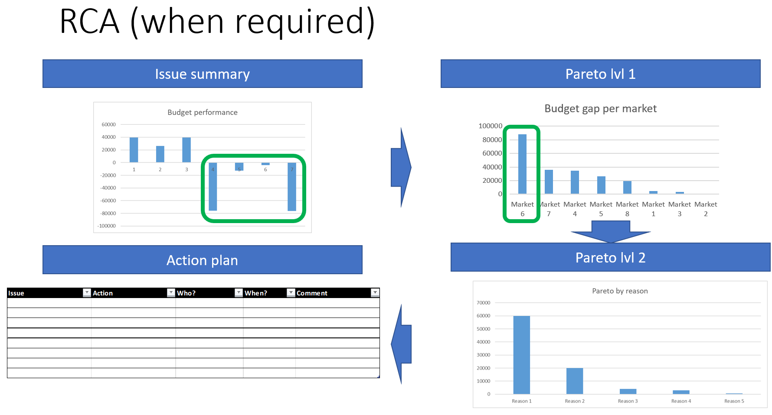
Darek

Slide 7
Retention
Mia/Ela
Retention vs New
Retention Pareto
Active/Inactive customers
Discount summary

Slide 8
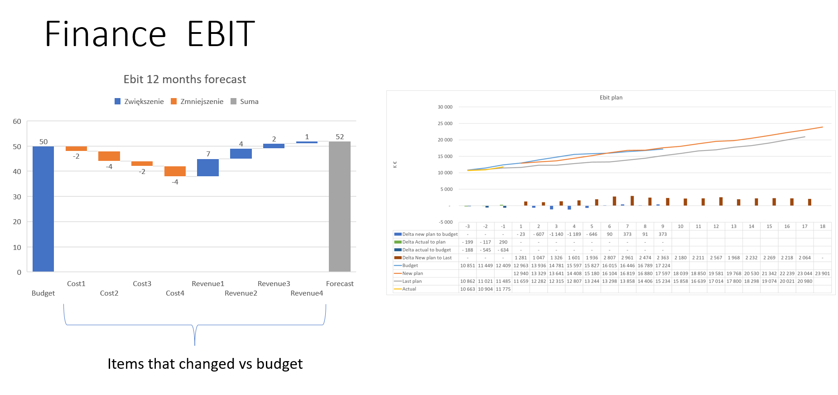
Maciek (Finance)
Maciek (Finance)
Comments/Notes

Slide 9
Demand - Actions
TBD
Area | Issue | Action | Who | When | Impact

Slide 10
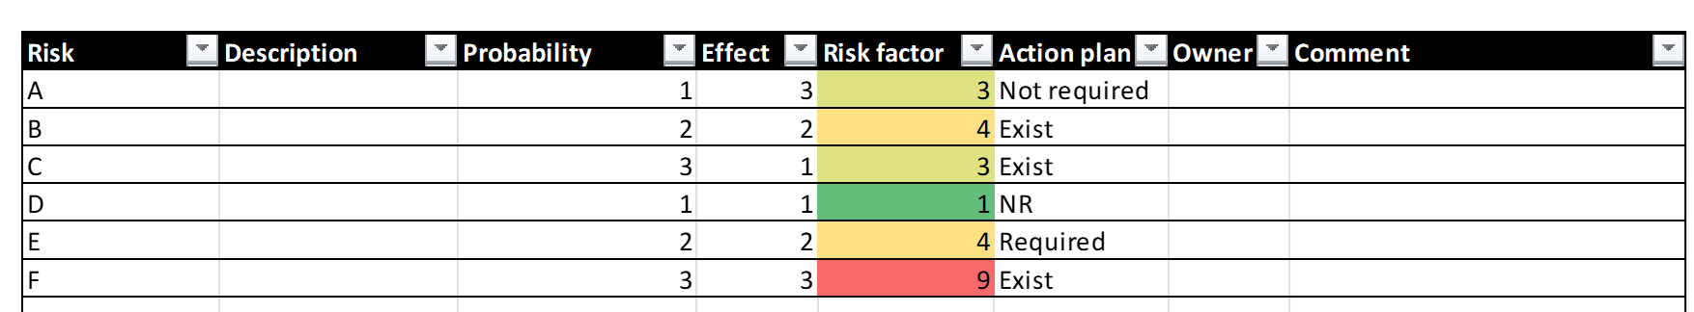
Demand risks and opportunities

Slide 11
S&OP Review

Slide 12
OTIF/Stockouts/Customer delivery
TBD
KPI (i.e. OTIF)

Slide 13
Supply
Agnieszka
Location | Stock (UOM? Tons? Days of supply?) | In Transit
Location A
->Product X
->Product Y
->Product Z
Location B
……………
Comments/Notes

Slide 14
Assets –– Missing Assets
# (%) = quanity/volume and % of total output
Artur
Location A | M-5 | M-4 | M-3 | M-2 | M-1
Type 1 | # (%)
Type 2 | # (%)
Type 3
…..
Total
Comments/Notes
Location B | M-5 | M-4 | M-3 | M-2 | M-1
Type 1
Type 2
Type 3
…..
Total

Slide 15
Assets -
Sławek
Stock of assets | Clients | Revamping (zdatne/niezdatne) | Depo | Filling Plant (zdatne/niezdatne)
Type 1
Type 2
Comments/Notes

Slide 16
Production Capacity - utilization
Piotr
Piotr
 |  | M-3 | M-2 | M-1 | M0 | M1 | M2 | M3 | M4 | M5 | M6 | M7 | M8 | M9 | M10 | M11 | M12
Plant1 | Area X | 74% | 56% | 67% | 87% | 77% | 66% | 61% | 58% | 68% | 62% | 65% | 85% | 71% | 85% | 87% | 61%
 | Area Y | 71% | 80% | 61% | 86% | 60% | 78% | 85% | 79% | 72% | 88% | 61% | 65% | 56% | 65% | 74% | 76%
 | Area Z | 58% | 59% | 74% | 68% | 84% | 81% | 64% | 60% | 74% | 78% | 65% | 83% | 59% | 67% | 56% | 88%
Plan2 | Area X | 64% | 68% | 75% | 84% | 58% | 63% | 76% | 72% | 72% | 84% | 60% | 78% | 62% | 61% | 56% | 60%
 | Area Y | 70% | 78% | 87% | 88% | 55% | 80% | 59% | 65% | 81% | 72% | 86% | 85% | 73% | 57% | 56% | 80%
 | Area Z | 76% | 67% | 67% | 55% | 57% | 88% | 72% | 70% | 79% | 77% | 66% | 83% | 69% | 75% | 57% | 65%
Comments/Notes

Slide 17
Logistics - utilization
Piotr
 |  | M-3 | M-2 | M-1 | M0 | M1 | M2 | M3 | M4 | M5 | M6 | M7 | M8 | M9 | M10 | M11 | M12
Area 1 | Type1 | 74% | 56% | 67% | 87% | 77% | 66% | 61% | 58% | 68% | 62% | 65% | 85% | 71% | 85% | 87% | 61%
 | Type2 | 71% | 80% | 61% | 86% | 60% | 78% | 85% | 79% | 72% | 88% | 61% | 65% | 56% | 65% | 74% | 76%
 | Type3 | 58% | 59% | 74% | 68% | 84% | 81% | 64% | 60% | 74% | 78% | 65% | 83% | 59% | 67% | 56% | 88%
Area 2 | Type1 | 64% | 68% | 75% | 84% | 58% | 63% | 76% | 72% | 72% | 84% | 60% | 78% | 62% | 61% | 56% | 60%
 | Type2 | 70% | 78% | 87% | 88% | 55% | 80% | 59% | 65% | 81% | 72% | 86% | 85% | 73% | 57% | 56% | 80%
 | Type3 | 76% | 67% | 67% | 55% | 57% | 88% | 72% | 70% | 79% | 77% | 66% | 83% | 69% | 75% | 57% | 65%
Comments/Notes

Slide 18
Subcontractors
Maciek (Tech)
Risks and issues summary
Comments/Notes

Slide 19
S&OP - Actions
TBD
Area | Issue | Action | Who | When | Impact

Slide 20
Demand risks and opportunities
TBD

Slide 21
KPI Dashboard

Slide 22
Agnieszka
TBD
Maciek
Budget Execution
Inventory Days of Cover
OTIF
Maciek
Sławek
TBD
Budget Gap
Assets Turns
Lost Sales
Maciek
Piotr
Artur
Forecast accuracy
Logistics Costs
Production Utilization
Mia/Ela
Sławek
Sławek
Retentions (in/out balance)
Revamping Costs
Revamping Rate
Piotr
???
Paweł
Operations costs
Telemetrics –fill rate
Stockouts

